Slide 1
Status of K-12 Public-School Education
Sindhu Veeramachaneni, Zachary Zalman,
Nathan Harris

Slide 2
Our Story Board for K-12 Public Education
IEA/OECD
PISA rankings
US and School States/Districts
Education factors
math & science, student/teacher, race, cost, graduation rates – Identified States based on PISA rankings
Trends
ESSA progress statewide initiatives
Competency Based Education policy trends
INTL rankings: PISA, TIMMS, & PIRLS: Top and Bottom US states in ranking
New Hampshire leading toward CBE

Slide 3


Notes:
IEA – International Educational Association
OECD – organization for Economic Cooperation & Development
What are these two organizations doing for International students – they are conducting assessments.
How often do they World-Wide conduct assessments – every three, four- and five-year assessments.
Why are they important? - helps to improve the education and build better lives in each individual.
IEA (International Association for the Evaluation of Educational Achievement).
Since 1958, IEA conducting TIMSS and PIRLS assessments for 8th and 4th graders and measured students’ mastery of subjects such as mathematics, science, and reading. there are more than 60 countries actively involved in IEA network.
OECD
The Organization for Economic Co-operation and Development (OECD) conducting PISA in more than 70 countries. For more than 50 years, the OECD has been a valuable source internationally. The OECD plays an important role in sharing information, data and measuring progress on poverty eradication or inequality for the betterment of humanity and children.

Slide 4
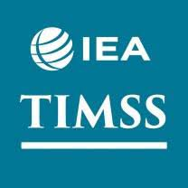


Notes:
Explain each assessment (PISA, TIMMS, PIRLS)
Programme for International Student Assessment --- PISA is a worldwide exam administered every three years that measures 15-year-olds in 72 countries.
in reading, mathematics and science.
Why choose 15-year-olds? Because in most countries, at the age of 15, students can decide whether or not they want to continue their education.
PISA – OECD conducts, every 3 years, for 15-year-old student, in 70 countries, last one in 2015 – math & science, reading. PISA assessments are designed to measure
practical applications of knowledge.
TIMSS Trends in International Mathematics and Science Study
Since 1995, TIMSS is administered every four years, at the fourth and eighth grades., 70 countries, last one in 2015, math & science
PIRLS
Progress In International Reading Literacy Study
Since 2001, PIRLS is administered ny IEA every five years, for 4th graders, 60 Countries, last one conducted in 2016, reading
Why PISA is important to our story?

Slide 5

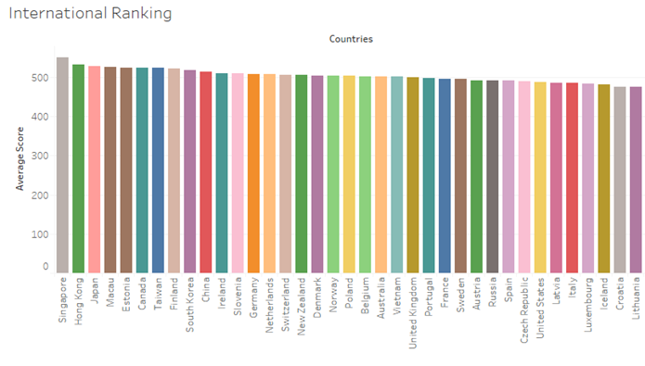
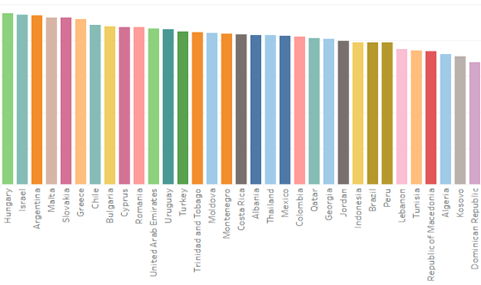
Notes:
**PISA is important because to our story because out of 70 countries tested, the USA is ranked 31!
PISA shows a sharp decline from 4th and 8th grade scores(TIMMS & PIRLS) – the gains of early education are not sustainable in the later years
The top spending on education and the lowest spending on education countries are?

Slide 6
Summary: US Public Education by Numbers
50.7 million
The number of students expected to attend public elementary and secondary schools this year—slightly more than in the 2017–18­ school year (50.6 million). About 5.9 million students are expected to attend private schools this year.
16.0
The expected number of public school students per teacher in fall 2018. This ratio has remained consistent at around 16.0 since 2010. However, the pupil/teacher ratio is lower in private schools (12.3) and has fallen since 2010, when it was 13.0.
$12,910
This is the projected per-student expenditure in public elementary and secondary schools in 2018–19. Total expenditures for public elementary and secondary schools are projected to be $654 billion for the 2018–19 school year.
3.6 million
The number of students expected to graduate from high school this academic year, including about 3.3 million from public schools and nearly 0.4 million from private schools.
19.9 million
This is the number of students expected to attend American colleges and universities this fall—higher than the fall 2000 enrollment of 15.3 million but lower than the peak of 21.0 million in 2010. About 13.3 million students will attend four-year institutions and 6.7 million will attend two-year institutions.
56.5%
The projected percentage of female postsecondary students in fall 2018, for a total of about 11.2 million female students, compared with 8.7 million male students.
National Center for Education Statistics
https://nces.ed.gov/blogs/nces/post/back-to-school-by-the-numbers-2018
Notes:
“There are 51 million students attending public schools in the United States.
The average student to teacher ration is 16 – in the highest PISA country the ratio is XX, the lowest XX
The per student expense is $13k, which equates to over $650 billion! That is more several small countries in PISA survey.
20 million total students will attend college in 2018, with 57% of them female.

Slide 7
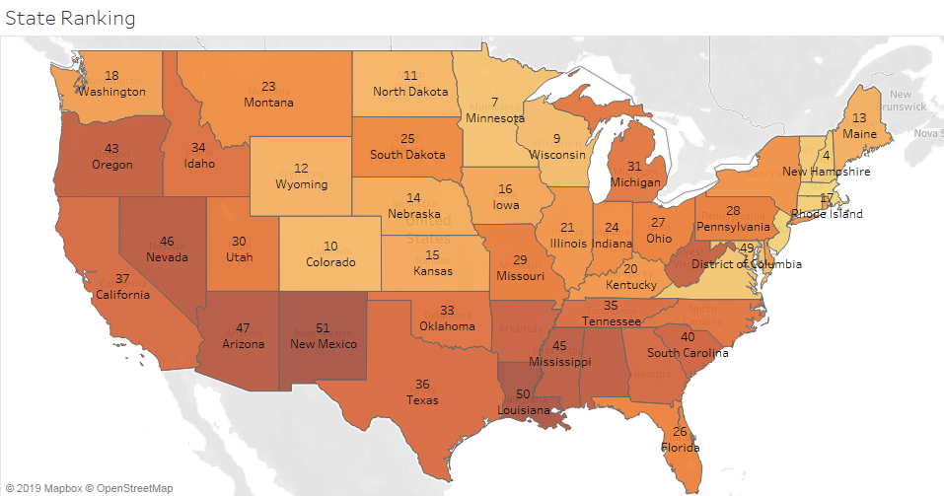

Massachusetts is ranked first in public education.
Sources: Data used to create this ranking were collected from the U.S. Census Bureau, U.S. Department of Education, National Conference of State Legislatures, National Center for Educational Statistics
Notes:
This map shows (2018) Public education school rankings
Which states are top and bottom of PISA rankings?
Need PISA data to correlate for Mega States – check state PISA scores
TIMSS and PIRLS is ranked above avg in mega states
Intresting facts: Define “Mega States -One-third of all public schools in USA are in these 5 states.
Demographics: Mega States serve more than half of the nation’s English language learners (ELL), as well as more than one-third of all families below the poverty line.
STATS: 18.7 million students, 2.9 million ELL students, Range of per-pupil expenditures [$8,562 (TX) to$17,746 (NY)]

Slide 8
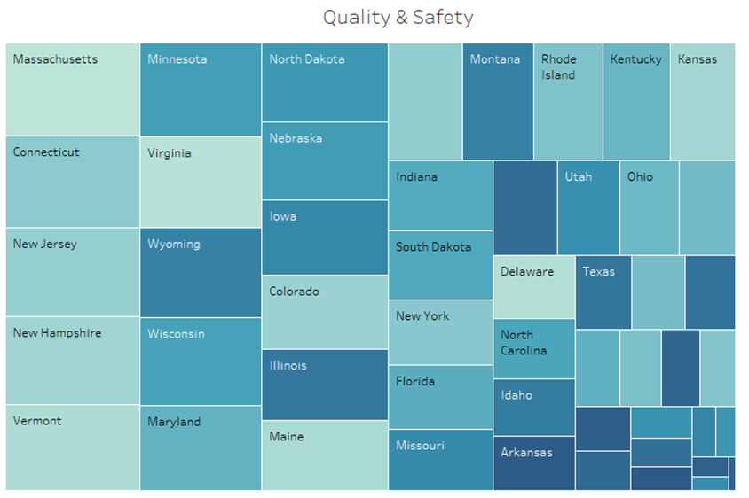
Color = Quality & Safety
Size = State Ranking
Data Source: https://wallethub.com/edu/states-with-the-best-schools/5335/
Notes:
“Quality” and “Safety” as key dimensions.
Factors included in order to determine the best and worst states for public-school education like
Drop-out Rate, Test Scores, Pupil-Teacher Ratio, Graduation Rates, Assessment criteria
New Hampshire is standing in top 5 states. New Mexico is rated last
At this point we have completed the first part of our story – I would like to turn the story over to my team member Zack to continue ☺
Quality – Total Points: 80
Presence of Public Schools in “Top 700 Best U.S. Schools”
Blue Ribbon Schools per Capita:
High School Graduation Rate Among Low-Income Students:
Projected High School Graduation Rate Increase Between 2018-2019 and 2031-2032 School Years
Dropout Rate
Math Test Scores:
Reading Test Scores
Safety – Total Points: 20
Share of Threatened/Injured High School Students
Share of High School Students Not Attending School Due to Safety Concerns
Share of Families Who Agree Their Children Go to Safe Schools
Share of High School Students with Access to Illegal Drugs
Share of High School Students Participating in Violence
Share of Armed High School Students: Full Weight
Number of School Shootings (2000-present (May 10, 2019))

Slide 9
Quality and Safety
Quality – Total Points: 80
Presence of Public Schools in “Top 700 Best U.S. Schools”
Blue Ribbon Schools per Capita:
High School Graduation Rate Among Low-Income Students:
Projected High School Graduation Rate Increase Between 2018-2019 and 2031-2032 School Years
Dropout Rate
Math Test Scores
Reading Test Scores
Safety – Total Points: 20
Share of Threatened/Injured High School Students
Share of High School Students Not Attending School Due to Safety Concerns
Share of Families Who Agree Their Children Go to Safe Schools
Share of High School Students with Access to Illegal Drugs
Share of High School Students Participating in Violence
Share of Armed High School Students
Number of School Shootings (2000-present (May 10, 2019))

Slide 10
US States
and
Districts

Slide 11
NAEP Math and Science Testing
Grade 4 | Grade 8 | Grade 12
Basic (214) | Basic (262) | Basic (141)
Proficient (249) | Proficient (299) | Proficient (176)
Advanced (282) | Advanced (333) | Advanced (216)
Math
Grade 4 | Grade 8 | Grade 12
Basic (131) | Basic (141) | Basic (142)
Proficient (167) | Proficient (170) | Proficient (179)
Advanced (224) | Advanced (215) | Advanced (222)
Science
National Science Foundation:
https://www.nsf.gov/statistics/state-indicators
National Assessment of Educational Progress:
https://nces.ed.gov/nationsreportcard/mathematics/achieve.aspx#grade12
https://www.nationsreportcard.gov/ndecore/xplore/NDE
Notes:
National Assessment of Education Progress
-federally run – national
-every 2 years
-subsample of pop
-only state and national data
-----------------------------------------------------------------------------------
Math:
-Scores for Grade 4 and Grade 8 are out of 500
-In 2005, the 12th grade mathematics assessment changed, so the scale is 0-300
-readjusted content as well (more advanced math topics)
-based on state standards and international measures
-----------------------------------------------------------------------------------
Science:
-Scores for Grade 4, Grade 8, and Grade 12 are out of 300
-In 2009, the Science framework was changed
-more subjects, changes in some subjects (space science)
-increased conceptual questions (Identifying and Using Science principles)
-----------------------------------------------------------------------------------
Different levels explained -> based on panel of educators/content experts
-currently in a trail stage of most current rankings
-may keep or change

Slide 12
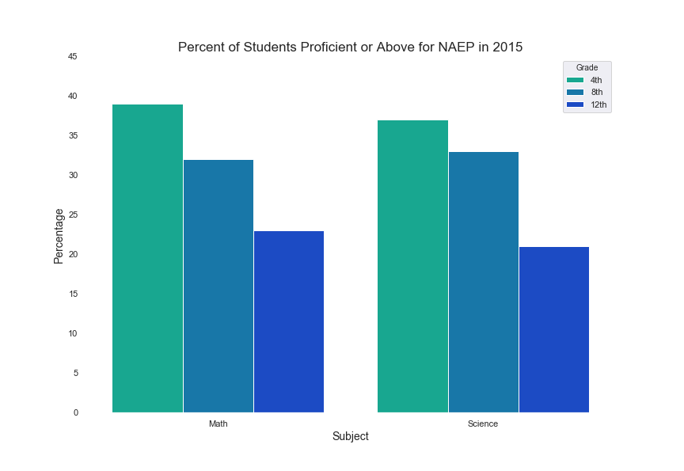
National Science Foundation:
https://www.nsf.gov/statistics/state-indicators
National Assessment of Educational Progress:
https://nces.ed.gov/nationsreportcard/mathematics/achieve.aspx#grade12
https://www.nationsreportcard.gov/ndecore/xplore/NDE
Notes:
Math and Science – 2015 (most recent year of data)
--------------------------------------------------------------------------------------------------------------------------------------------
Drop in proficiency levels between 4th, 8th, and 12th Grade
-more pronounced for grade 12
--------------------------------------------------------------------------------------------------------------------------------------------
Similar drop in Intl testing - the gains of early education in 4th and 8th grade are not sustainable in the later high school years.
-This is consistent with PISA results.

Slide 13
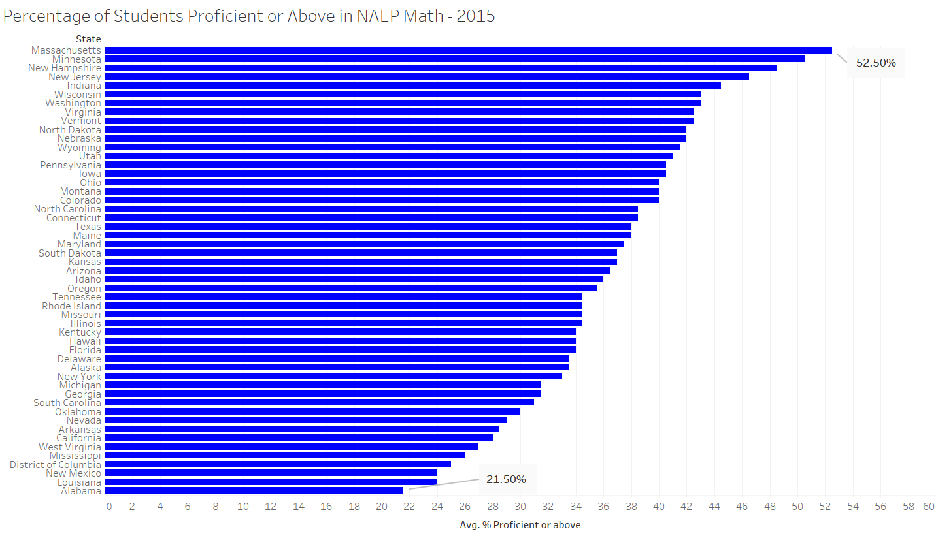
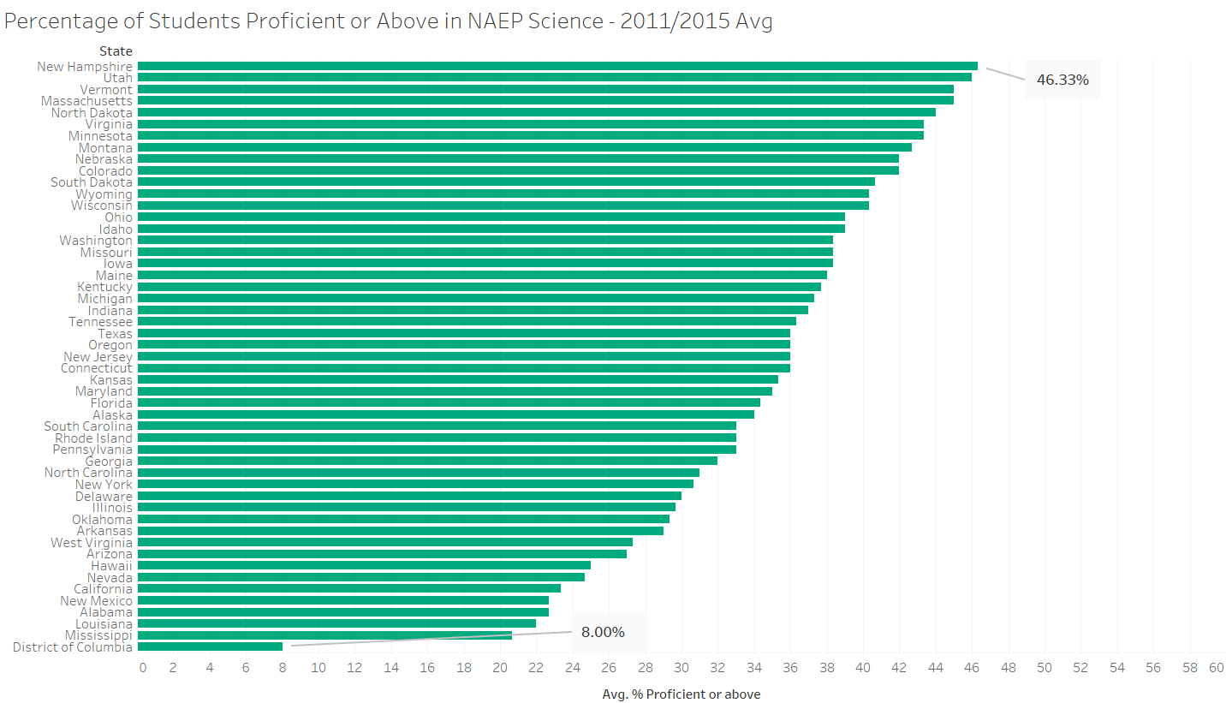
National Science Foundation:
https://www.nsf.gov/statistics/state-indicators
National Assessment of Educational Progress:
https://nces.ed.gov/nationsreportcard/mathematics/achieve.aspx#grade12
https://www.nationsreportcard.gov/ndecore/xplore/NDE
Notes:
Rankings of the states based on most recent NAEP scores
---------------------------------------------------------------------------
Math:
-2015
-MA, NH, NJ near top (MA #1)
-AL, LA, NM bottom
-Top states much more proficient than middle/bottom
---------------------------------------------------------------------------
Science:
2011/2015 Average -> missing data from 2015
-NH, VT, UT at top
-LA, NM, AL still at bottom, with DC
-similar trend to math, but no top peak

Slide 14
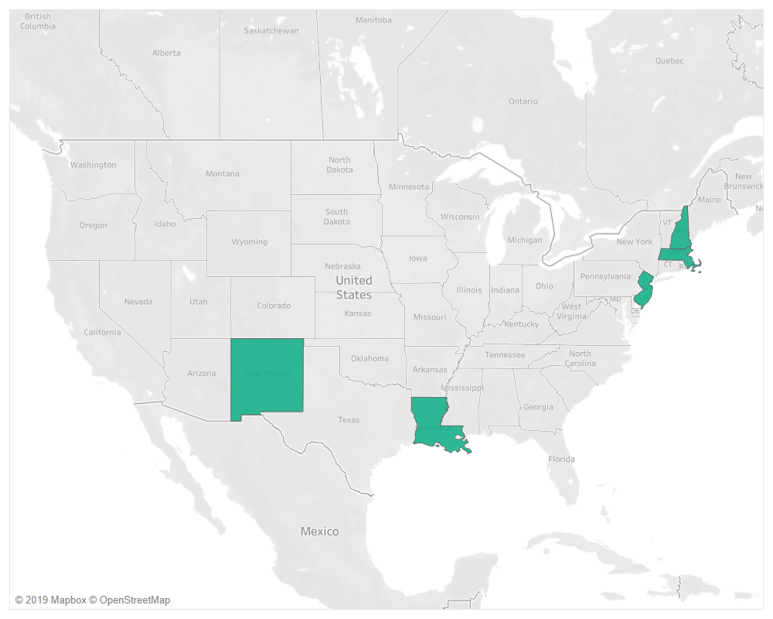
Selecting States to Examine
Top States:
Massachusetts
New Jersey
Bottom States:
Louisiana
New Mexico
Also Selected:
New Hampshire
Notes:
Took top and bottom states from PISA ranking
-Compared to the states in the NAEP score ranking to ensure states represented the top and bottom
Also looked at New Hampshire
-Near top
-where we live
-Nathan knows it

Slide 15
Selecting States to Examine
Top States:
Massachusetts
New Jersey
Bottom States:
Louisiana
New Mexico
Also Selected:
New Hampshire
Notes:
Took top and bottom states from PISA ranking
-Compared to the states in the NAEP score ranking to ensure states represented the top and bottom
Also looked at New Hampshire
-Near top
-where we live
-Nathan knows it

Slide 16
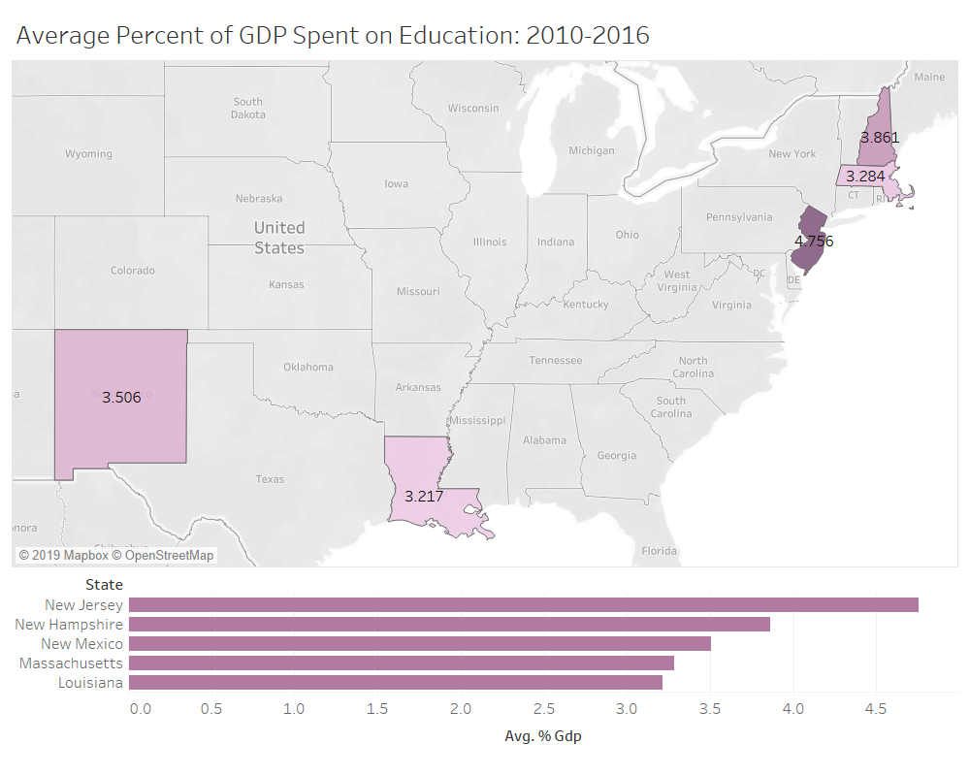
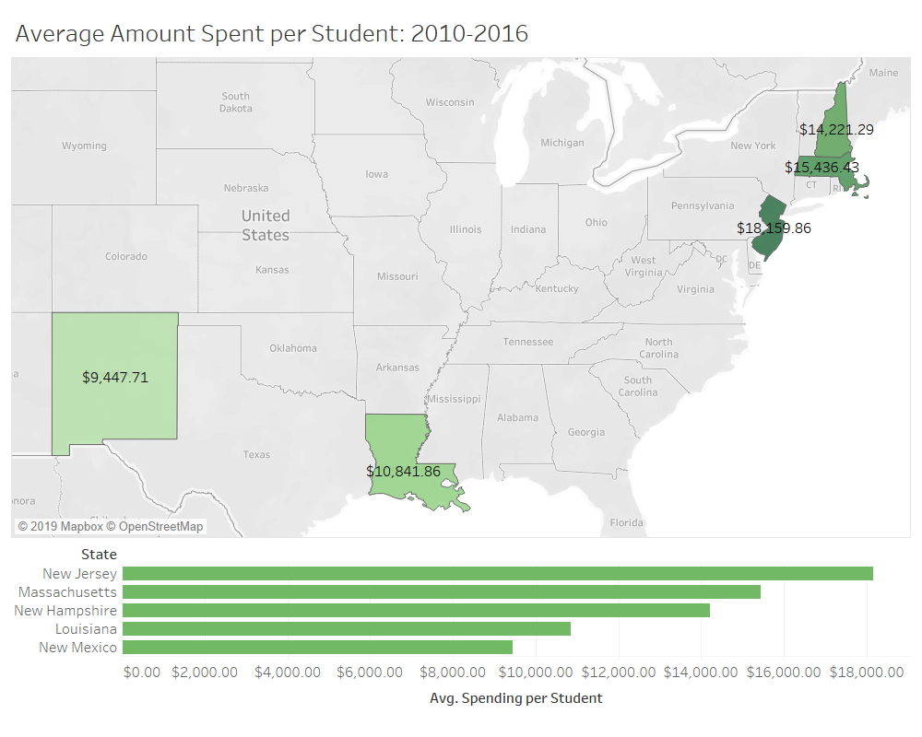
National Science Foundation:
https://www.nsf.gov/statistics/state-indicators
Notes:
NEAP States money
-GDP % and $/student
-Averaged for past 7 years to smooth it out
----------------------------------------------------------------------------
National Ranges:
GDP: 1.381% (DC) to 5.349% (VT)
-average: 3.4%
$/Student: $6,533.29 (UT) - $20,611.85 (DC)
-average: $8,614.85
----------------------------------------------------------------------------
GDP:
-Not much difference in percent GDP between the states
-NM is not on bottom
----------------------------------------------------------------------------
$/Student:
-more in line with ranking

Slide 17
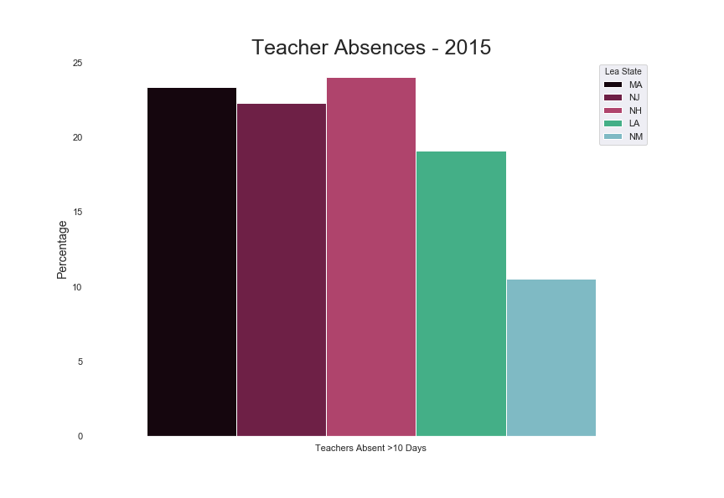
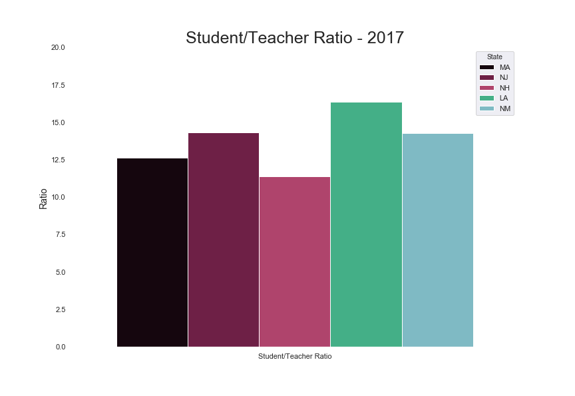
U.S. Department of Education:
https://www2.ed.gov/about/inits/ed/edfacts/data-files/
index.html#acgr
NCES -> Elementary/Secondary Information System
https://nces.ed.gov/ccd/elsi/
U.S. Department of Education:
https://ocrdata.ed.gov/flex/Reports.aspx?type=district
Notes:
Absences - 2015:
-inverse to ranking
-MA, NJ, NH high
-LA low
-NM very low
-possible factors:
-better school infrastructures -> more processes in place to allow it (subs, etc)
-no pressure to against calling in
--------------------------------------------------------------------------------------------------------------------
Student/Teacher Ratio - 2017:
-generally lower in states with higher ranking, vice-versa

Slide 18
Why Bin the Rankings?
Group Size | Example of Range
1-5 | Suppressed (PS)
6-15 | <50%, ≥50%
16-30 | ≤20%, 21-39%, 40-59%, 60-79% ≥80%
31-60 | ≤10%, 11-19%, 20-29%, 30-39%, 40-49%, 50-59%, 60-69%, 70-79%, 80-89%, ≥90%
61-300 | ≤5%, 6-9%, 10-14%, 15-19%, 20-24%, 24-29%, 30-34%, 35-39%, 40-44%, 45-49%, 50-54%, 55-59%, 60-64%, 65-69%, 70-74%, 75-79%, 80-84%, 85-89%, 90-94%, ≥95%
More than 300 | ≤1%, 2%, 3%, . . . , 98%, ≥99%
Data collected by state, local, and school agencies, then centralized by federal government
Ranked in ranges to protect identities within small and medium groups
U.S. Department of Education:
https://www2.ed.gov/about/inits/ed/edfacts/data-files/
index.html#acgr
Notes:
reflects data as reported by state education agencies to EDFacts
-ED checks, but data anomalies may still be present
-------------------------------------------------------------------------------
FERPA (Family Educational Rights and Privacy Act) is reasoning for bins

Slide 19
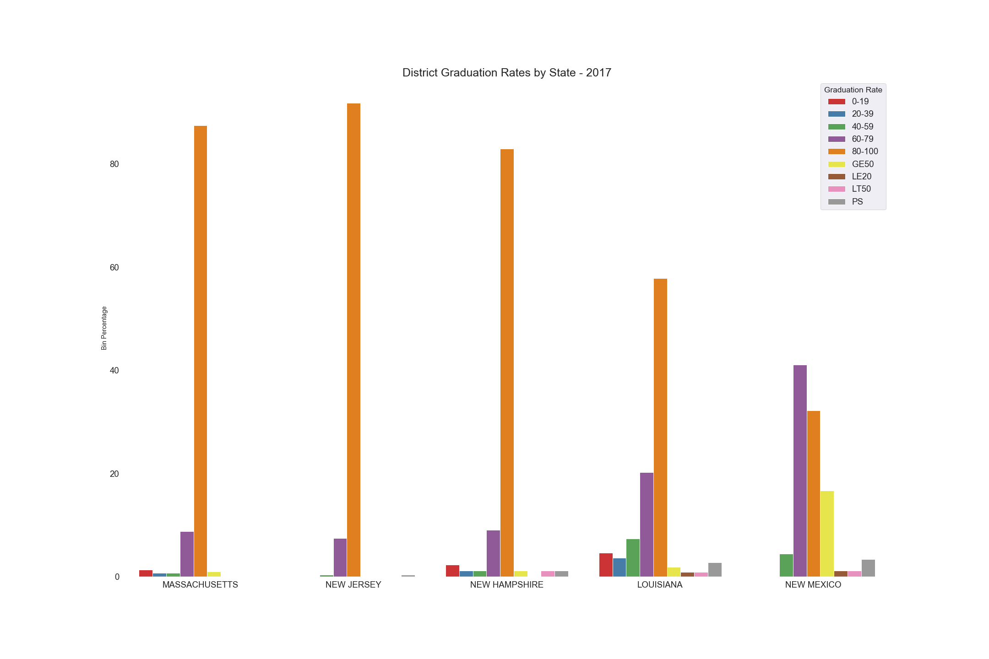
U.S. Department of Education:
https://www2.ed.gov/about/inits/ed/edfacts/data-files/
index.html#acgr
NCES -> Elementary/Secondary Information System
https://nces.ed.gov/ccd/elsi/
Notes:
4-Year Adjusted Cohort Rate for 2017 (most recent year):
Number of cohort members who earned a regular high school diploma within 4 years/
Number of first-time 9th graders in fall 2011 (starting cohort) + students who transferred in - students who transferred out, emigrated, or died in the 4 years
------------------------------------------------------------------------------------------------------
Most districts in each state have graduation rates of 80-100%
-NM is exception, with 60-79%
------------------------------------------------------------------------------------------------------
Higher counts in 80-100% compared to other ranges within the top states (MA, NJ, NH)
-LA still has a large portion in 80-100%, but it has higher counts in 60-79% as well

Slide 20
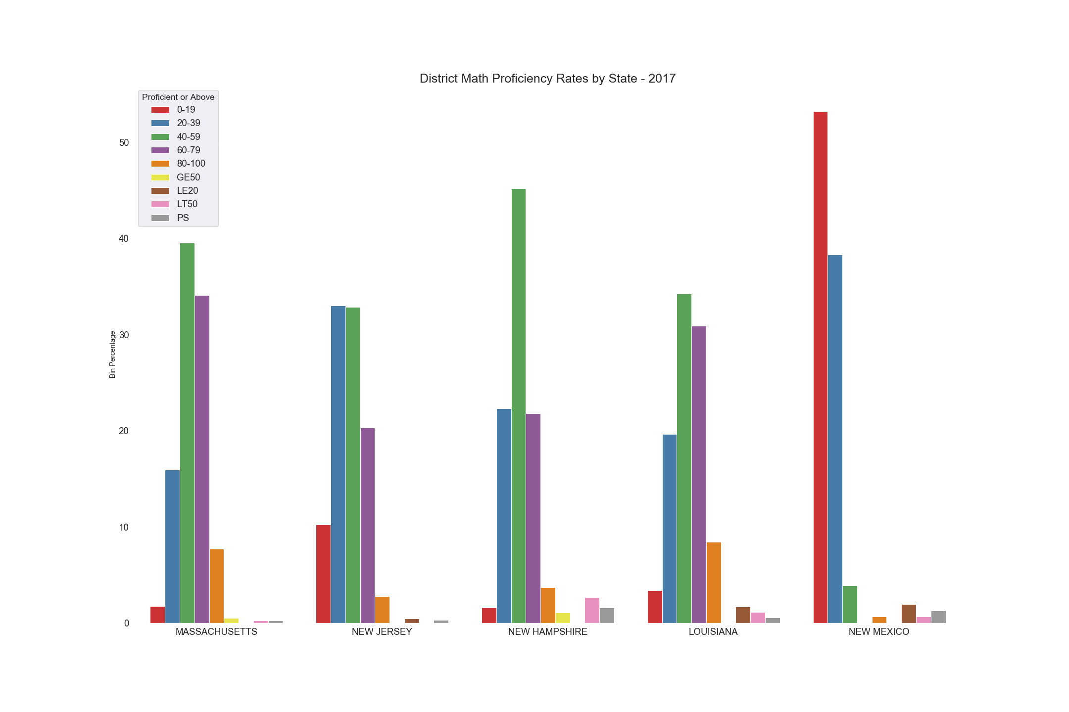
U.S. Department of Education:
https://www2.ed.gov/about/inits/ed/edfacts/data-files/
index.html#acgr
NCES -> Elementary/Secondary Information System
https://nces.ed.gov/ccd/elsi/
Notes:
Math State Assessments -2017 (most recent year):
-Students assessed annually in 3rd through 8th grade, and at least once in high school
-’Proficient or Above’ defined as the number of students achieving the ‘proficient’ or ‘advanced’ rating
-defined by State Education Agency
---------------------------------------------------------------------------------------------------------------
Most districts in each state have proficiency rates of 40-59%
-NM is exception, with 0-19%
LA is higher than NJ
-state requirements may be lower
States seem similar in proficiency level spread
-Exception is NM
---------------------------------------------------------------------------------------------------------------
Trend -> higher ranking states have better grade rates and better math proficiency

Slide 21
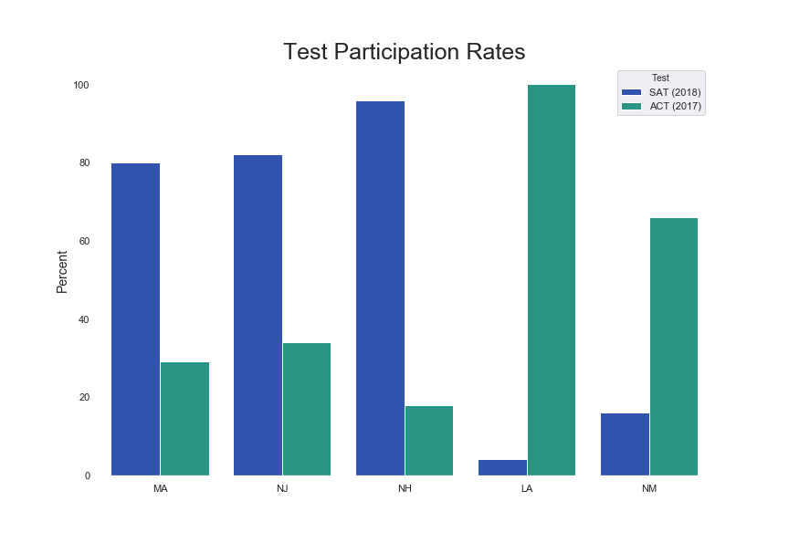
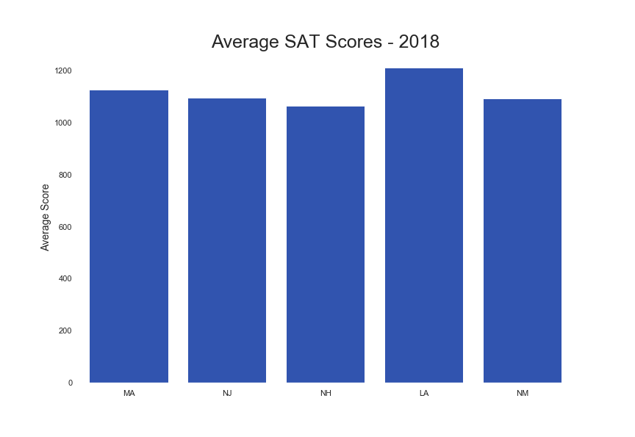
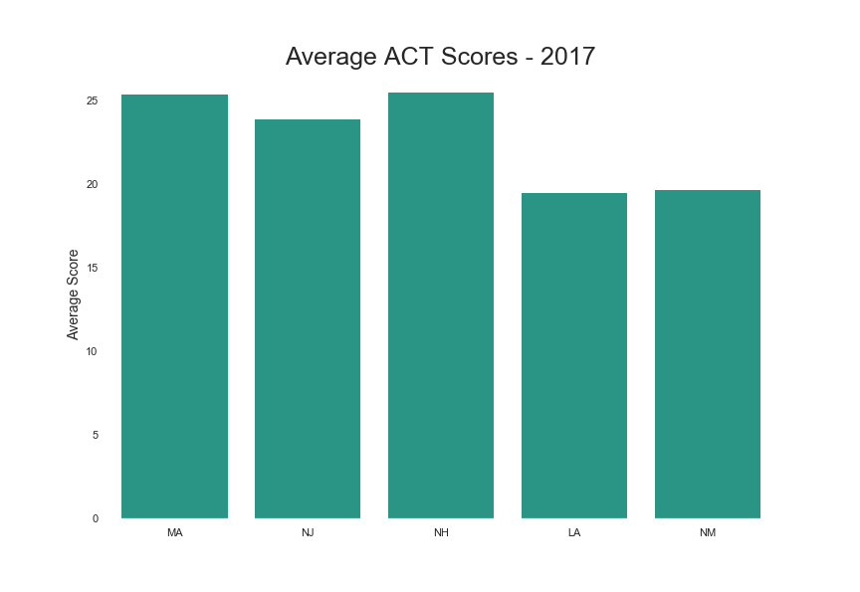
Notes:
Average ACT and SAT scores by state
-ACT is 2017 (out of 36)
-SAT is 2018 (out of 1600)
----------------------------------------------
NM, LA more ACT
MA, NH, NJ more SAT
----------------------------------------------
Higher participation = lower average score comparatively
-only best students taking it in low participation states?

Slide 22
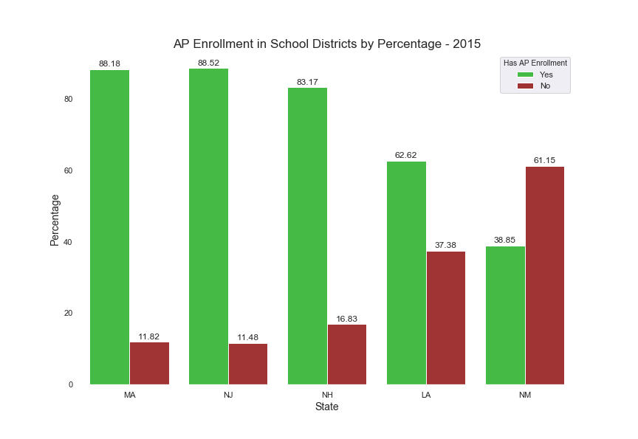
AP Enrollment in school districts for the states in 2015
-Lots of districts are missing responses to this question
-Percentage of districts that answered
LA: 60.80%
MA: 74.00%
NH: 47.80%
NJ: 49.18%
NM: 81.76%
U.S. Department of Education:
https://ocrdata.ed.gov/flex/Reports.aspx?type=district
Notes:
AP Enrollment – 2015 (most recent year)
-----------------------------------------------------------------------------------------------------
States with a higher ranking generally show a higher amount of districts with AP Enrollment
-MA, NH, NJ all above 80%
-LA is close to 60%
-NM is below 40%
-----------------------------------------------------------------------------------------------------
There appears to be a relationship between having a higher AP enrollment and ranking
-Ratio of Yes/No decreases at lower ranks, then more No for NM

Slide 23
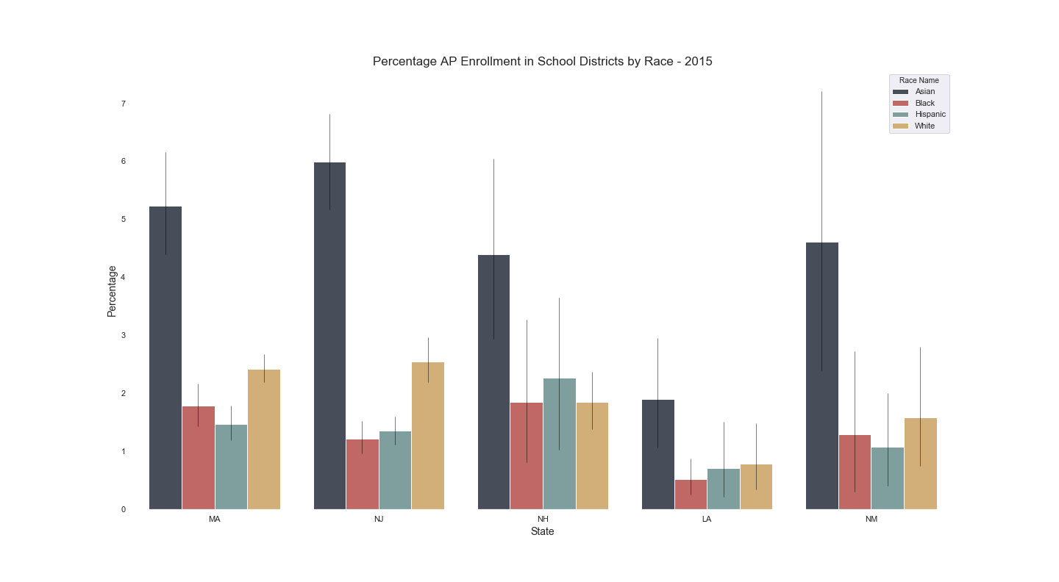
U.S. Department of Education:
https://ocrdata.ed.gov/flex/Reports.aspx?type=district
Notes:
Percentage of students in the district enrolled in AP Mathematics – 2015 (most recent year):
------------------------------------------------------------------------------------------------------
Clearly highest -> Asian
-across all states regardless of rank
-cultural?
------------------------------------------------------------------------------------------------------
Rest of the races are similar to each other across states
------------------------------------------------------------------------------------------------------
Looked at race for the math proficiency and grad rates:
-very similar trends
-redundant to show
------------------------------------------------------------------------------------------------------
Transition to Nathan:
-About trends
-Resident education expert

Slide 24


Slide 25
Similar results for PISA
National Science Foundation:
https://www.nsf.gov/statistics/state-indicators
National Assessment of Educational Progress:
https://nces.ed.gov/nationsreportcard/mathematics/achieve.aspx#grade12
https://www.nationsreportcard.gov/ndecore/xplore/NDE
Notes:
Math and Science – 2015 (most recent year of data)
--------------------------------------------------------------------------------------------------------------------------------------------
Drop in proficiency levels between 4th, 8th, and 12th Grade
-more pronounced for grade 12
--------------------------------------------------------------------------------------------------------------------------------------------
Similar drop in Intl testing - the gains of early education in 4th and 8th grade are not sustainable in the later high school years.
-This is consistent with PISA results.

Slide 26
What factors account for decline in proficiency from 8th grade thru High School?
Factors:
Literacy is central to poor STEM result
  Student cannot adequately read STEM artifacts—map, chart, graph, spreadsheet, etc...
Entrenched High School education structure – influence by Carnegie system (time in seats) and College Board requirements (Standardized Tests)
Teacher certification & training
  Teacher preparation showed the largest gap, one that widens greatly for prospective secondary STEM teachers, where coursework on disciplinary literacy is scarce. Many Inservice science teachers never received appropriate university training on negotiating technical texts, writing for STEM, or engaging in peer review. Teachers without these experiences avoid them in their secondary classrooms, when texts, concepts, and tasks become more complex. (“Equity & Representation in STEM”, LITERACY TODAY | May/June 2019 | literacyworldwide.org )
Notes:
HS have been off the radar – attention and efforts were focused on standards for K-8, and thus graduation requirements & testing were driving HS curriculum and output (AP, SAT, ACT, PSAT),

Slide 27
HS were off the radar – attention and efforts were focused on standards for K-8, and thus graduation requirements & testing driving HS curriculum and output (AP, SAT, ACT, PSAT)
  K-8 has seen the most active reform, though not everywhere. Statewide adoptions at these levels make them more attractive to publishers/professors who get grants to build one-off learning modules and sometimes entire programs.
  Due to far fewer requirements at these levels, the curriculum can be more fluid and thus it is easier to change. The recent spate of standardized tests in 4th and 8th grade have made schools focus only on math and reading, at the expense of science, social studies, the Arts—and recess!!! But now elementary schools are seeing the light and facing parent backlash, and they have the ability to revert to more balance because of the lack of “real” curriculum requirements. Common Core and NGSS have influence, but only as far as testing is concerned
  Interestingly, elementary schools in affluent suburban areas like Westchester, NY have no incentive to follow standards because their students test well anyhow. So their pedagogy has not changed much over the past two decades.
  In those SAME wealthy areas and prep schools, they worship SATs, Aps because their students do well. So it is easier for them to maintain the test-prep slog in HS because that keeps parents happy. So the wealthy areas made big, bad bets at primary AND secondary levels---at primary they refuse to follow standards and at secondary they absolutely worship tests, quite the opposite response but for the same reason—that is what works best for their student populations.

Slide 28
Trends

Slide 29


Personalized Learning
and the Every Student Succeeds Act
Mapping Emerging Trends for Personalized Learning in State ESSA Plans
March 2018
Notes:
policy trends that span the following issues:

Slide 30
Important Education Events
1965 Elementary and Secondary Education Act-ESEA (1965) >>> No Child Left Behind-NCLB (2001)
  Established the federal government's expanded role in public education, and standardized tests.
Every Student Succeeds Act (ESSA) is a US law passed in December 2015 that governs the United States K-12 Public Education policy.
  What happen – ESSA gave states greater flexibility to design K-12 education systems that align to their vision for student success.
What is Every Student Succeeds Act (ESSA)?
Notes:
ESSA Requirements: 1 State Vision, 2 Accountability Systems & Accountability, 3 School Support and Improvement, 4 Supporting Excellent Educators, 5 Supporting All Students

Slide 31









ESSA and Personalized Learning Dashboard
39 state ESSA plans reference personalized learning.
VISION
17 states
incorporate personalized learning into their vision
for ESSA implementation.
ACCOUNTABILITY
SCHOOL
IMPROVEMENT
states
will prioritize personalized learning strategies for supporting schools identified
for improvement.
states
will prioritize strategies for meaningful
community engagement in the development and implementation of school improvement plans.
19 states
will establish dashboards
to provide parents, students, and other education stakeholders with comprehensive data on school quality and student opportunities.
25 states
will use an academic proficiency indicator that accounts for the performance level of each student in a school, such as scale scores or performance indices, incentivizing improved performance for each student regardless of whether they
score below or above proficient.
EXCELLENT EDUCATORS
10 states
will explore the development of a
statewide system of micro-credentials for educators to personalize and enhance professional development.
14 states
will launch an online professional development platform for educators to make personalized professional development available anytime, anywhere.
SUPPORTING ALL STUDENTS
21 states
will prioritize the use of Title IV
funds to support schools and districts to
offer social-emotional learning and
whole child supports to enhance or improve existing course offerings.
19 states
will ensure all students have a personalized learning plan that aligns to their academic needs, interests, and goals.
35 states
will incorporate a high school indicator that emphasizes multiple pathways
for demonstrating college and career readiness.
37 states
will incorporate an extended-year
graduation rate indicator providing credit for schools that successfully graduate students who need additional time.
https://knowledgeworks.org/resources/essa-personalized-learning-dashboard/

Slide 32
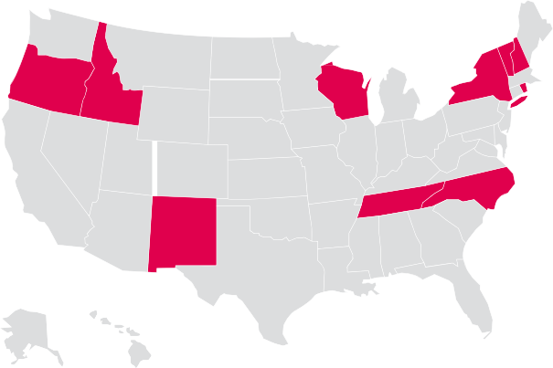
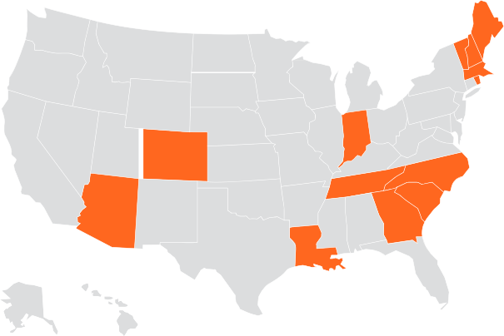
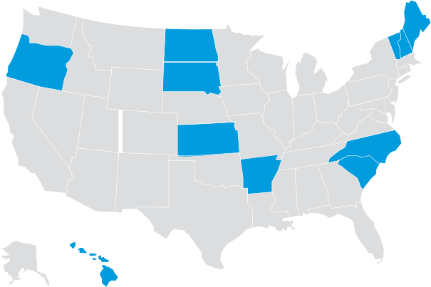
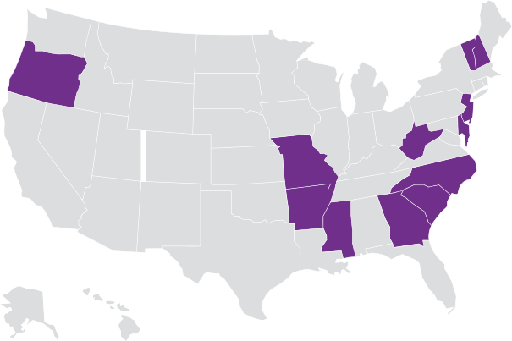
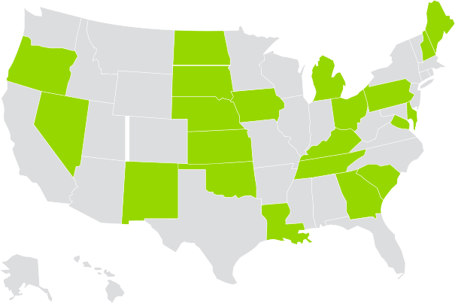

STATE VISION
Visual snapshot of how states are advancing their approaches
SCHOOL IMPROVEMENT
SUPPORTING ALL STUDENTS
EXCELLENT EDUCATORS
ACCOUNTABILITY SYSTEMS
Notes:
SI - Personalized learning is emphasized in school improvement strategies
SV - Competency-based practices are integrated into a vision for personalization
AS - The academic proficiency indicator incorporates scale scores and/or performance indices that account for the performance level of each student in a school.
EE- Educator preparation programs align to student-centered learning systems.
SAS - Technology enhances student personalized learning experiences.

Slide 33
Trend # 2

Slide 34





Five Elements of Competency-Based Education
Students advance upon demonstrated mastery.
Competencies include explicit, measurable, transferable learning objectives that empower students.
Assessment is meaningful and a positive learning experience for students.
Students receive timely, differentiated supports based on their individual learning needs.
Learning outcomes emphasize competencies that include application and creation of knowledge, along with the development of important skills and dispositions.
Notes:
Definition – time in seats

Slide 35
Carnegie unit ( time in the seat)
The Carnegie Unit is 120 hours of class or contact time with an instructor over the course of a year at the secondary (American high school) level.
  The Carnegie Unit and the Student Hour are strictly time-based references for measuring educational attainment used by American universities and colleges; the Carnegie Unit assesses secondary school attainment, and the Student Hour, derived from the Carnegie Unit, assesses collegiate attainment.
    The Carnegie unit does not require demonstrated mastery of subject; the institution is responsible for ensuring learning.
Notes:
Widespread adoption of the 120-hour secondary standard did not occur until the Carnegie Foundation (established in 1906) began to provide retirement pensions (now known as TIAA-CREF) for university professors with the qualification that universities must enforce the 120-hour secondary standard. By 1910, nearly all secondary institutions in the United States used the "Carnegie Unit" as a measure of secondary course work.

Slide 36
Why Competency Bases Education Matters
About 1 million students a year leave high school without a diploma.
The current system [Carnegie units] allows students to progress because of age, not demonstrated ability. This is resulting in gaps – some small, some big, all damaging.
70% of higher education instructors said their students do not comprehend complex reading materials; 66% said students cannot think analytically.
Our graduates do not achieve the level of academic and career skills as those of other countries. This makes them less competitive in a global economy.
Students families and states bear the burden of a time-based education system. Colleges cost $2.3 billion per year.
Notes:
Incarceration population = . > 40% had not received a high school diploma (2003) https://www.bjs.gov/content/pub/pdf/ecp.pdf
“One size fits all’

Slide 37
How Widespread is Competency-based Education?

Slide 38
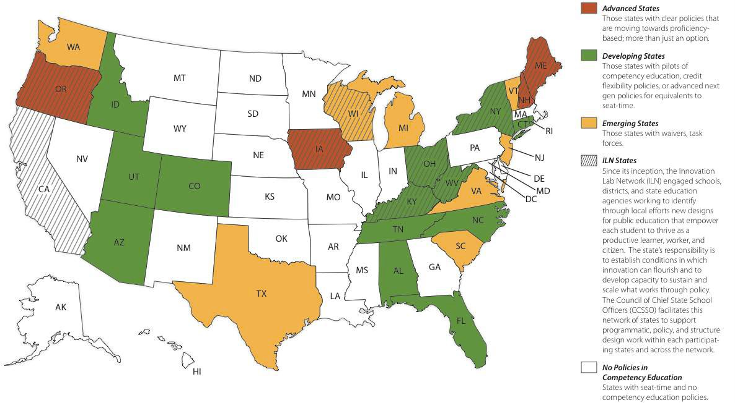
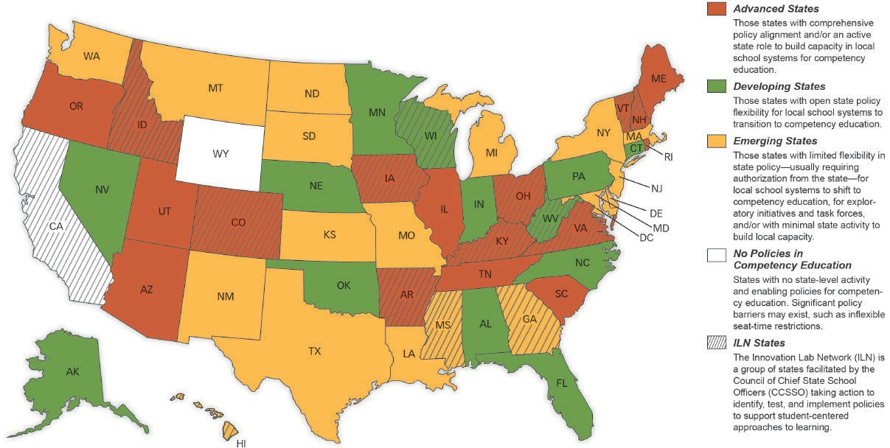
Competency-Based Education State Policy
2012
2018
Notes:
Talk thru color chart
Our five states > NH is advanced

Slide 39

Grand Father of Competency Based Education
NH

Slide 40
New Hampshire
Actions Toward Creating Competency Based Education System

Slide 41
New Hampshire’s CBE Journey Continued
Performance Assessment of Competency Education (PACE)
…is a first-of-its-kind pilot that replaces standardized tests with personalized, authentic assessments developed by New Hampshire teachers.
KEY ASPECTS OF PACE
What. NH PACE is a learning system designed to capitalize on the latest advances in understanding of how people learn.
When. NH PACE began as a two-year pilot, after ESSA – to reduce the level of standardized testing & incorporate locally developed common performance.
Best way to show how it works in NH
https://www.facebook.com/reachinghighernh/videos/503413976800771/
https://reachinghighernh.org/2018/10/03/usdoe-applaud-innovative-assessment/
Notes:
The goal is to structure learning opportunities that allow students to grapple with gaining meaningful knowledge and skills at a depth of understanding that they can transfer to new real-world situations. As a coherent system, NH PACE is designed to foster positive organizational learning and change by supporting the internally-driven motivation of educators instead of the all-too common top-down accountability approaches where the goals and methods of the accountability system are defined at the state or federal levels and districts are simply expected to comply.

Slide 42
NH’s PACE Language
Multiple stakeholders, including state leaders, experts in assessment and accountability, and district and school leaders, work together to create a plan for the design, implementation and scaling of a reciprocal accountability system that ensures all students have opportunities to gain critical knowledge and skills.
PACE includes:
» High-quality common performance tasks;
» Locally designed performance tasks with guidelines for ensuring high technical quality;
» Regional scoring sessions and local district peer review audits to ensure sound accountability systems and high inter-rater reliability;
» A web-based bank of local and common performance tasks; and
» A regional support network for districts and schools.
The PACE assessments are designed to support deeper learning through competency education and are closely integrated into students’ day-to-day work, which makes the assessments more meaningful. Students demonstrate their competency through multiple performance assessment measures in a variety of contexts.
Notes:
The goal is to structure learning opportunities that allow students to grapple with gaining meaningful knowledge and skills at a depth of understanding that they can transfer to new real-world situations. As a coherent system, NH PACE is designed to foster positive organizational learning and change by supporting the internally-driven motivation of educators instead of the all-too common top-down accountability approaches where the goals and methods of the accountability system are defined at the state or federal levels and districts are simply expected to comply.

Slide 43
Grade 12 continuously enrolled students will be eligible for counting as postsecondary ready by meeting any two of the following ten requirements:
indicator of student success is a career and college readiness indicator.
Completion of a New Hampshire Scholars program of study (Standard, Science, Technology, Engineering and Mathematics [STEM] or Arts)
C or better in a dual-enrollment course
SAT scores (480 in Evidence-Based Reading and Writing and 530 in Math)
American College Testing (ACT) scores (18 in English, 22 in Mathematics, 22 in Reading and 23 in Science)
A score of 3, 4 or 5 on an Advanced Placement (AP) exam
A score of 5, 6 or 7 on an International Baccalaureate (IB) exam
Earning a Career and Technical Education (CTE) industry-recognized credential
Completion of a state career pathway program of study • Scoring at least Level III on components of the Armed Services Vocational Aptitude Battery (ASVAB) that comprise the Armed Forces Qualifying Test
Completion of the ACT National Career Readiness Certificate

Slide 44
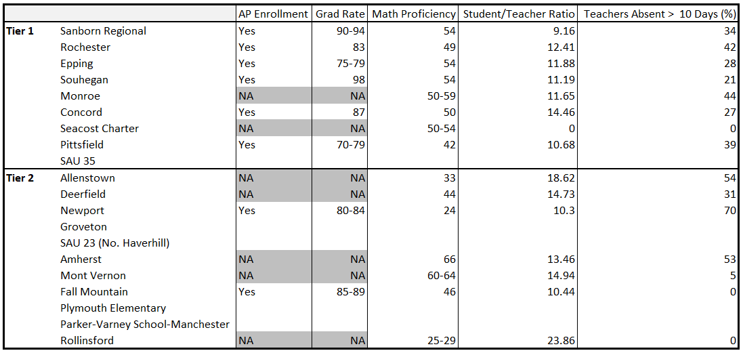
2017 Reporting: PACE Tier 1 and Tier 2 Schools
Notes:
AP, Grad Rates, Teacher Absent – 2017
S/TR – 2016

Slide 45
2018-2019 PACE Schools for Accountability
SAU 8
Abbot-Downing School Beaver Meadow School Broken Ground School Christa McAuliffe School Rundlett Middle School
SAU 23
Warren Village School Bath Village School Piermont Village School
Woodsville Elementary (grade 3) Haverhill Middle School
SAU 54
East Rochester School Nancy Loud School
McClelland School William Allen School
Chamberlain Street School Rochester Middle School School Street School Gonic School
Maple Street Magnet School
SAU 9
Pine Tree Elementary School
SAU 35
Bethlehem Elementary School
SAU 14
Epping Elementary School Epping Middle School
SAU 39
Amherst Middle School
SAU 77
Monroe Consolidated School
SAU 17
Daniel J. Bakie School
Sanborn Regional Middle School Memorial School
SAU 43
Richards Elementary School Newport Middle School
Public Charter Schools
Seacoast Charter School
Notes:
NH Stats
There are 187 high schools in New Hampshire, made up of 111 public schools and 76 private schools. New Hampshire ranks as the 41st state in terms of student enrollment and 42nd in terms of total number of schools. It ranks 5th for the student/teacher ratio and sits 2nd for the percentage of students on free or reduced lunches. https://high-schools.com/directory/nh/

Slide 46
Our Story Board for K-12 Public Education
IEA/OECD
PISA rankings
US and School States/Districts
Education factors
math & science, student/teacher, race, cost, graduation rates – Identified States based on PISA rankings
Trends
ESSA progress statewide initiatives
Competency Based Education policy trends
INTL rankings: PISA, TIMMS, & PIRLS: Top and Bottom US states in ranking
New Hampshire leading toward CBE

Slide 47
Important Observations
International Assessment(s) mirrors USA high School decline in math and science.
AP enrollment in general is higher for better ranked states.
ESSA is reshaping assessment and accountability requirements.
Competency state-based education initiatives are increasing in high percentage across the country.

Slide 48
Important Observations
International Assessment(s) mirrors USA high School decline in math and science.
AP enrollment in general is higher for better ranked states.
ESSA is reshaping assessment and accountability requirements.
Competency state-based education initiatives are increasing in high percentage across the country.

Slide 49
Thank you!

